Slide 1
Computer Networks and Internets
《计算机网络与因特网》课件
林坤辉

Slide 2
Chapter 1 Introduction
1.1 Growth of Computer Networking
Two decades ago, few people had access to a network.
Now, computer communication has become an essential part of our infrastructure, computer networks are everywhere.
the growth in networking has an economic impact as well.

Slide 3
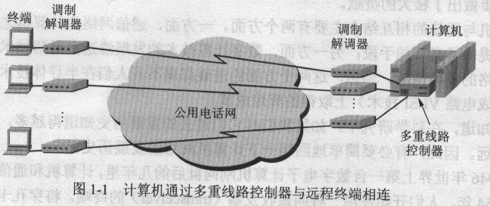
1.1.1 Resource Sharing
Early digital computers were extremely expensive and scarce.
The first networks were designed to share large-scale computational power.

Slide 4
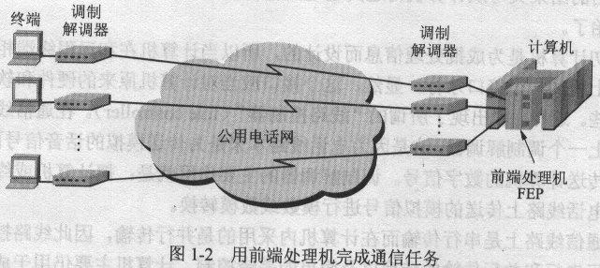
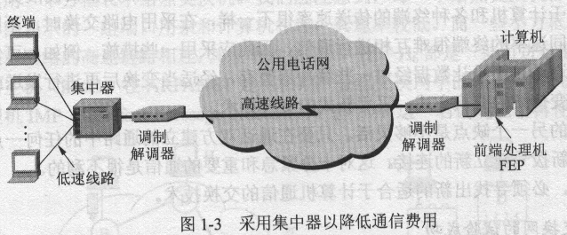

Slide 5
ARPA(高级研究计划署) was especially concerned about the lack of high-powered computer.
By the latter 1960s, ARPA started investigating data networking.
The ARPA networking research turned out to be revolutionary.
A working system called the ARPANET.
A technology known as internetworking

Slide 6
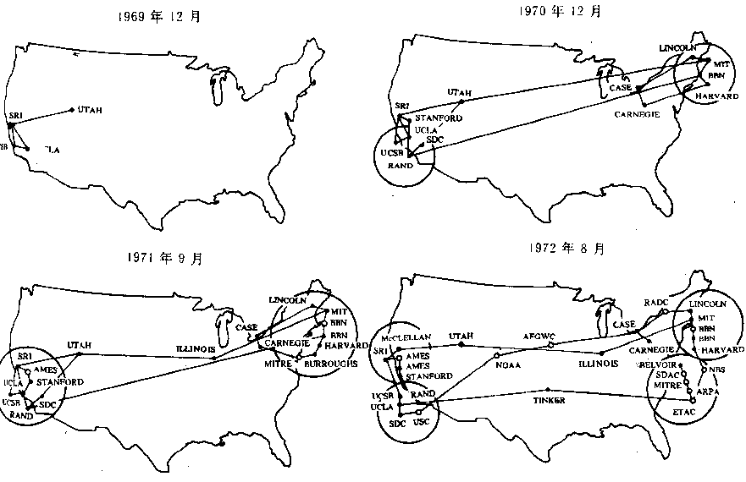

Slide 7

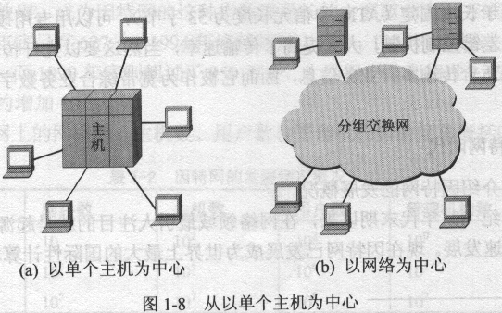

Slide 8
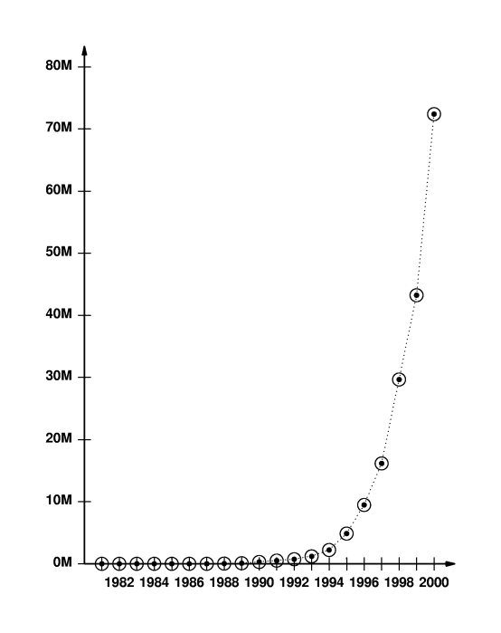
1.1.2 Growth of The Internet
The Internet has grown from the early research prototype(原型) to a global communication system that reaches all countries of the world.

Slide 9
1.2 Complexity In Network systems
Many technologies exist, and each technology has features that distinguish it from the others.
Multiple organization have created networking standards independently, which are not all compatible.
Multiple technologies exist that can be used to interconnect two or more networks. .

Slide 10
There is no single underlying theory that explains the relationship among all parts.
The set of technologies is diverse and changing rapidly.
There is no simple and uniform terminology for networking concepts.
Because multiple organizations define networking technologies and standards, multiple term exist for a given concept.

Slide 11
1.3 Mastering Complexity
To master the complexity,one must look beyond the details and concentrate on understanding concepts.
The text focuses on concepts and avoids unnecessary detail.
Whenever possible, the text uses analogies(类比) and illustration(图解) to simplify explanations .

Slide 12
1.5 Organization of The Text
The text is divided into four major parts.
The first part describes data transmission.
The second part of the text focuses on packet(包) transmission.
The third part of the text covers internetworking.
The fourth part of the text explains networking applications.

